Slide 1
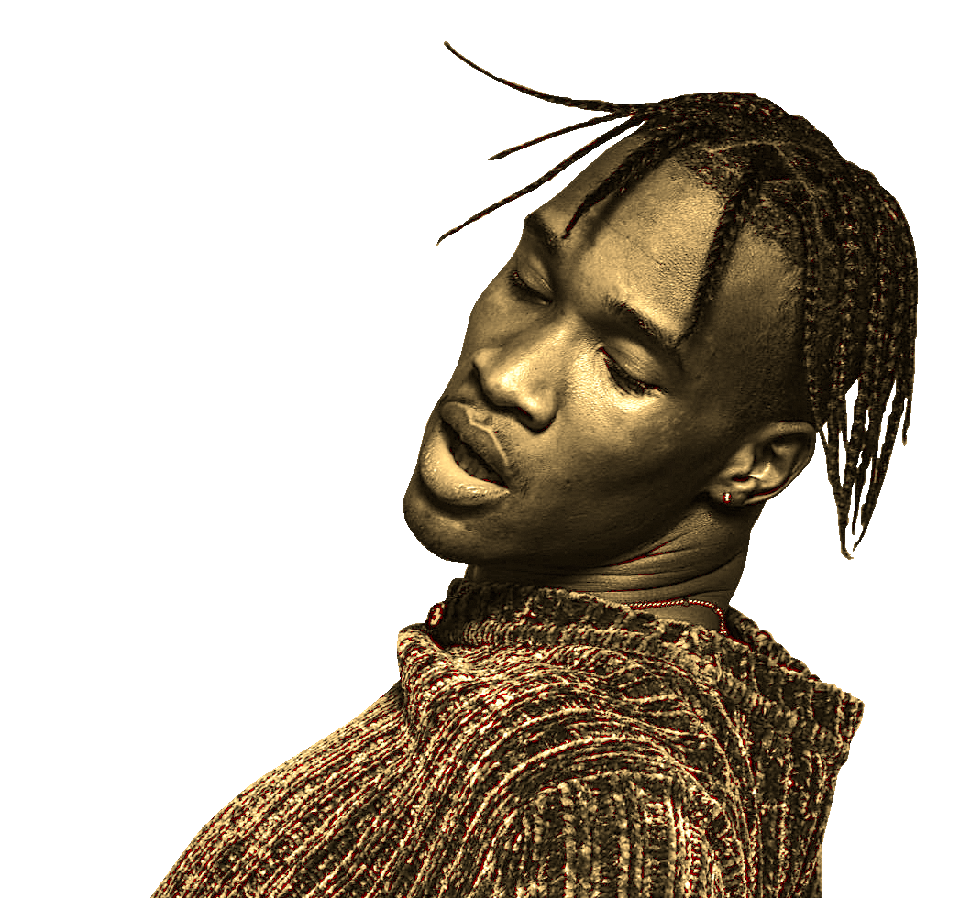

CS584
Atharv Subhekar
Nidhi Sura
Nikhil Shah
GROUP 6:
APPLICATION OF NLP TECHNIQUES ON SONG LYRIC DATA
PROJECT

Slide 2

CONTENTS
INTRODUCTION
PROJECT SUBPARTS & CHALLENGES
APPROACH
DATA COLLECTION
PREPROCESSING
INSIGHTS & ANALYSIS
MODEL – GENRE CLASSIFICATION
RESULTS – GENRE CLASSIFICATION
MODEL – LYRIC GENERATION
RESULTS – LYRIC GENERATION
GENERATED SONG

Slide 3
INTRODUCTION
In the dynamic world of music, a fresh perspective on genre classification has emerged—analyzing lyrics through sentiment analysis. Beyond traditional auditory features, this approach dives into the emotional essence of songs. By leveraging sentiment analysis, we explore how the sentiments expressed in lyrics can unveil distinctive emotional landscapes, paving the way for a nuanced understanding of various music genres. This brief journey explores the synergy between lyrics and sentiment analysis, revealing how emotional tones contribute to the unique identity of each musical genre.

Slide 4
PROJECT SUBPART
GENRE CLASSIFICATION
Genre ambiguity
Newly emerging and evolving genres
Multiple-genre influences
LYRIC GENERATION
CHALLENGES
Maintaining genre authenticity
Incorporating genre-specific vocabulary
Creative versatility (curb stereotyping)

Slide 5
APPROACH
Data Collection - We are using the lyrics dataset from Kaggle which has all the necessary information which is mainly song and artist names, song lyrics and their genres.
Data Preprocessing - We have implemented various techniques to convert the lyrics into tokens and dynamically labeled them using during
Data Statistics – We can analyze the basic statistics of the data set from the following histograms plots and wordclouds.

Slide 6
Data Collection
The data used for our project was a Kaggle Dataset, made up of songs from 79 different genres
Song lyrics from 79 musical genres
All the data was obtained by scraping the Brazilian website Vagalume using R.

Slide 7
PreProcessing
Stoplist and Symbols Removal
Text Cleaning Function: Created a cleanText function to strip whitespaces, replace newline and carriage return characters, and convert text to lowercase.
Data Loading, Deduplication and Filtering:
Loaded artist data from a CSV file and removed duplicates based on a 'Link' column.
Loaded lyrics data, renamed a column to match with the artist data, and then merged the two datasets on the 'Link' column.
Filtered the merged dataset to retain only rows where the 'language' column is 'en' (English).
Genre Labeling:
Mapped musical genres to numerical labels and applied this mapping to the 'Genres' column of the English-only dataset.
Converted the genre labels into a NumPy array.

Slide 8
PreProcessing
Data Splitting
Data Parsing and Tokenization: Tokenized the lyrics data in the train, validation, and test sets using a simple_tokenizer function.
Vocabulary and GloVe Weight Matrix Construction:
Constructed a vocabulary using CountVectorizer on the tokenized training data, adjusting the vocabulary indices.
Initialized a GloVe vectors matrix and populated it with vectors for each word in the vocabulary.
Data Indexing and Padding:
Transformed the tokenized data into indices using the doc_to_index function.
Padded the indexed data using the pad_sequence function for train, validation, and test datasets.

Slide 9
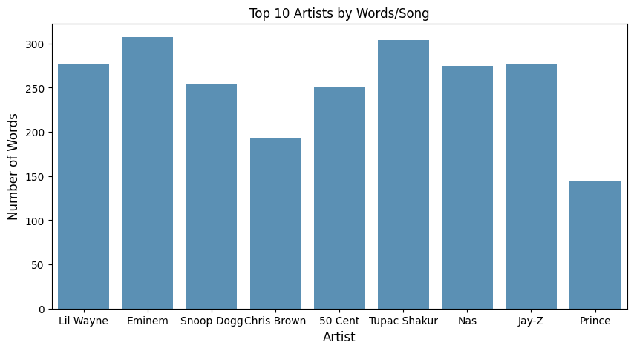
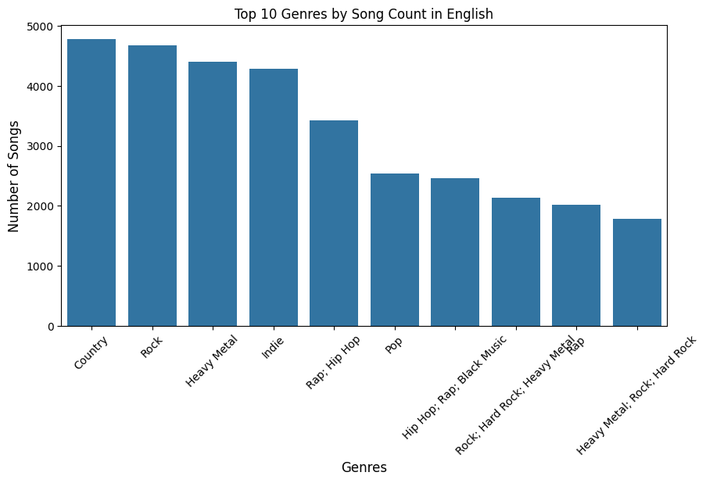
INSIGHTS & ANALYSIS

Slide 10
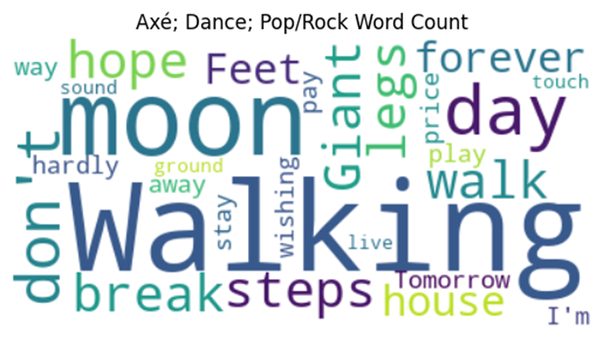
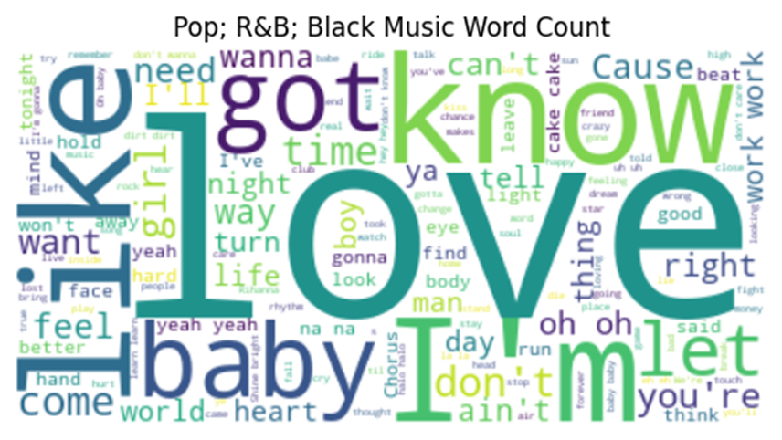
INSIGHTS & ANALYSIS

Slide 11
The Model
The motivation to use Long Short-Term Memory (LSTM) model stems from the fact that lyrics are inherently sequential in nature, and the similarity between two lyrics must in at least some way be determined by the similarities between their sequences over time.
We have made use of dense vectors to represent words. For the purpose of this project, we will be used GloVe embeddings.
To address overfitting since the corpus is 5000 lyrics we incorporated dropout rates.
LSTM (Long Short-Term Memory) are very good for analyzing sequences of values and predicting the next one. For example, LSTM could be a good choice if you want to predict the very next point of a given time series.

Slide 12
THE MODEL
Embedding Layer: The model starts with an embedding layer. If a pre-trained weight matrix (such as GloVe embeddings) is provided, it uses that for embedding; otherwise, it initializes a new embedding layer with a specified vocabulary size and embedding dimension.
LSTM Layer: Following the embedding layer, the model employs an LSTM (Long Short-Term Memory) layer. LSTM is useful for processing sequences (like text) as it can capture long-range dependencies and contextual information. The LSTM layer has configurable parameters like hidden dimensions, number of layers, and dropout probability.

Slide 13
THE MODEL
Attention Mechanism: The model includes a custom attention mechanism (Attention class) which computes attention scores based on the LSTM's outputs. This mechanism allows the model to focus on specific parts of the input sequence when making predictions, which is particularly useful for understanding the context and nuances in text data.
Dropout and Fully Connected Layer: After the attention mechanism, the model applies dropout for regularization, followed by a fully connected linear layer to map the LSTM outputs to the desired output size.
Output: The final output is designed to represent the sentiment of the input text. The model can be used for binary classification (positive/negative sentiment) or multi-class sentiment classification, depending on the specified output size.

Slide 14
RESULTS
Test Loss: 46.62%, Test Accuracy: 89.70%

Slide 15
Lyric generation
Genre – Country Music
Model – LSTM based architecture (Sequential-LSTM-Dense)
Seed text – Small town boy (very common country music phrase)
Training – 20 epochs (batch size = 128)
Tokenization - Implemented word & character; selected word tokenization
Why such a simple model?
Future work!

Slide 16
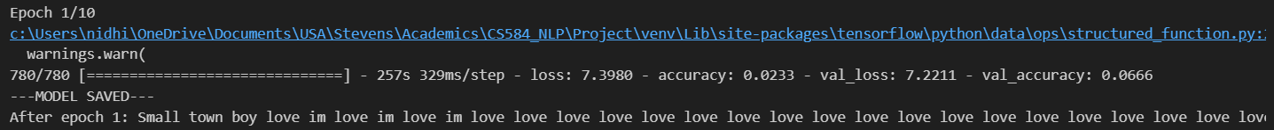
LYRIC GENERATION BY EPOCH

Slide 17
LYRIC GENERATION BY EPOCH

Slide 18
Model training

Slide 19
GENERATED LYRICS
Epoch 1:
Small town boy love
im love im love im love
love love love love
love love love love
love love love love
love love love love
love love love love
love love love love
love love love love
love love love love
love love love love
love love love love
love love love
Epoch 20:
Small town boy man
im gon na see nobody
thats gon na break rusty cage
run run back back back
tennessee homesick
midnight homesick blues
mama aint got ta go back
way back Tennessee
i´m goin back
tennessee homesick blues
got ta kick back relax
tennessee homesick blues
got ta kick back relax

Slide 20
THANK YOU

